Slide 1

UNIVERSITY INSTITUTE OF ENGINEERING
COMPUTER SCIENCE ENGINEERING
Bachelor of Engineering (Computer Science & Engineering)
Subject Name: Block chain Technology
Subject Code: 20_CST-412
Mapped with CO3
Ethereum and Smart contracts
Prepared By:
Er. Ankita Sharma
DISCOVER . LEARN . EMPOWER

Slide 2
Table of contents
Smart contracts
Need Of smart contracts
Benefits of smart contracts
Turning Completeness
Ethereum Blockchain
Features of ethereum block chain
Difference between Bit coin and Ethereum block chain

Slide 3
Smart contracts
Smart contract are computer programs stored on the block chain that allows us to convert traditional contracts into digital parallels.
Smart contracts are very logical - following an “if this then” that structure.
This means they behave exactly as programmed and cannot be changed.
They typically are used to automate the execution of an agreement so that all participants can be immediately certain of the outcome, without any intermediary’s involvement or time loss.

Slide 4
Need for smart contracts
One of the biggest problems with a traditional contract is the need for trusted individuals to follow through with the contract's outcomes.
There is no central authority
The contract is between two parties
No involvement of third party
Faster execution of transaction
Smart contract is deployed on ethereum block chain
Smart contract is written in solidity language

Slide 5
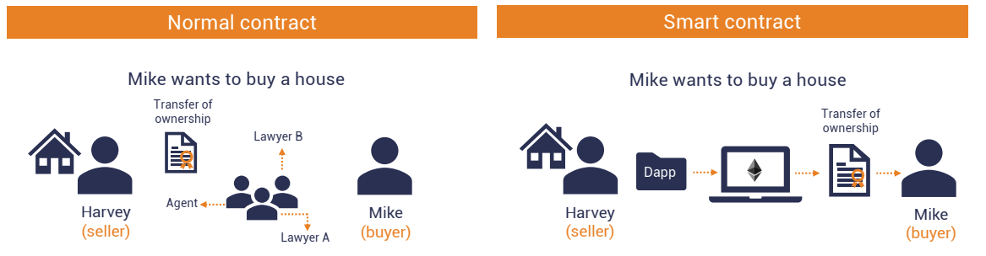

Slide 6
How smart contracts work
Smart contracts work by following simple “if/when…then…” statements that are written into code on a block chain.
A network of computers executes the actions when predetermined conditions have been met and verified.
These actions could include releasing funds to the appropriate parties, registering a vehicle, sending notifications, or issuing a ticket.
The block chain is then updated when the transaction is completed.
That means the transaction cannot be changed, and only parties who have been granted permission can see the results.
Within a smart contract, there can be as many confirmations as needed to satisfy the participants that the task will be completed satisfactorily.

Slide 7
Features of Smart contracts
Automatic execution
One of the most significant benefits smart contracts have over regular contracts is that the outcome is automatically executed when the contract conditions are realized.
There is no need to wait for a human to execute the result.
In other words: smart contracts remove the need for trust.
For example, you could write a smart contract that holds funds in escrow for a child, allowing them to withdraw funds after a specific date. If they try to withdraw the funds before the specified date, the smart contract won't execute.

Slide 8
Predictable outcomes
The human factor is one of the biggest points of failure with traditional contracts.
For example, two individual judges may interpret a traditional contract in different ways. Their interpretations could lead to different decisions getting made and disparate outcomes.
Smart contracts remove the possibility of different interpretations. Instead, smart contracts execute precisely based on the conditions written within the contract's code.
This precision means that given the same circumstances, the smart contract will produce the same result.

Slide 9
Public record
Smart contracts are also useful for audits and tracking.
Since Ethereum smart contracts are on a public block chain, anyone can instantly track asset transfers and other related information.
You can check to see that someone sent money to your address,
Privacy protection
Smart contracts can also protect our privacy.
Since Ethereum is a pseudonymous network (your transactions are tied publicly to a unique cryptographic address, not your identity), you can protect your privacy from observers.

Slide 10

Benefits of smart contracts

Slide 11
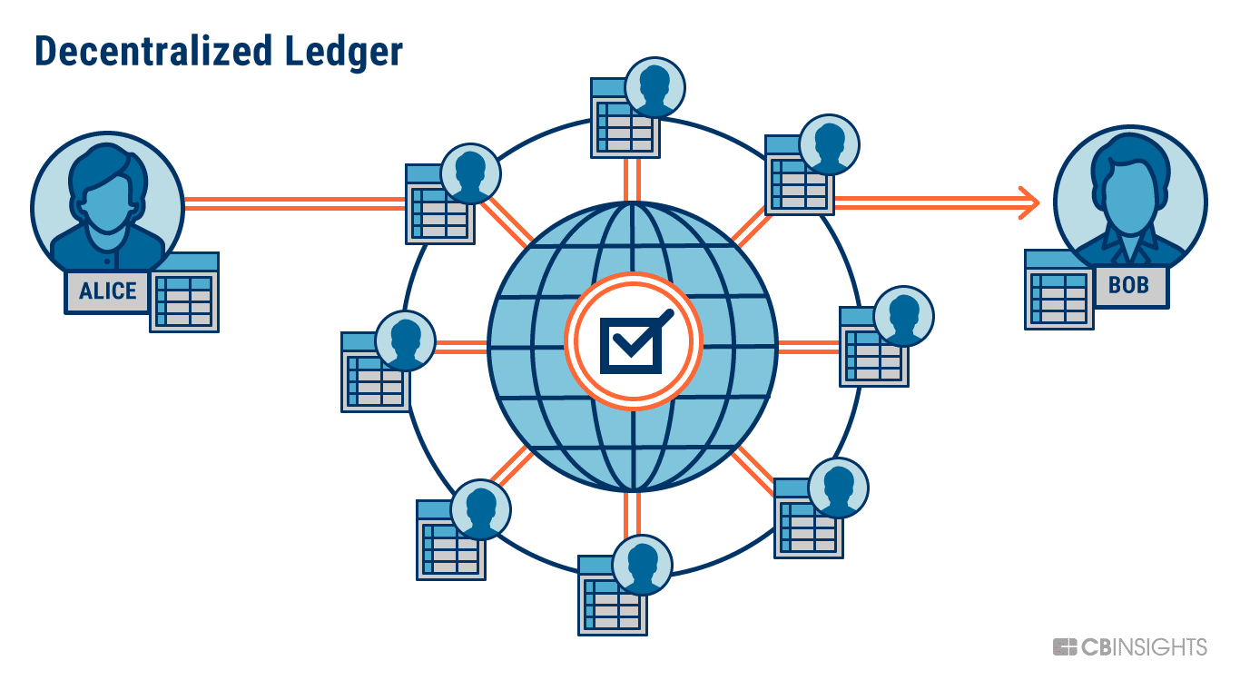
Ethereum block chain
Ethereum is an open-source block chain platform that enables the creation and execution of decentralized applications (dApps) and smart contracts. A block chain is a distributed ledger that records and verifies transactions across a network of computers.
The Ethereum block chain operates on a consensus mechanism called Proof of Stake (PoS), where network participants (known as validators) are chosen to create and validate new blocks based on the amount of Ether they hold and are willing to "stake"

Slide 12
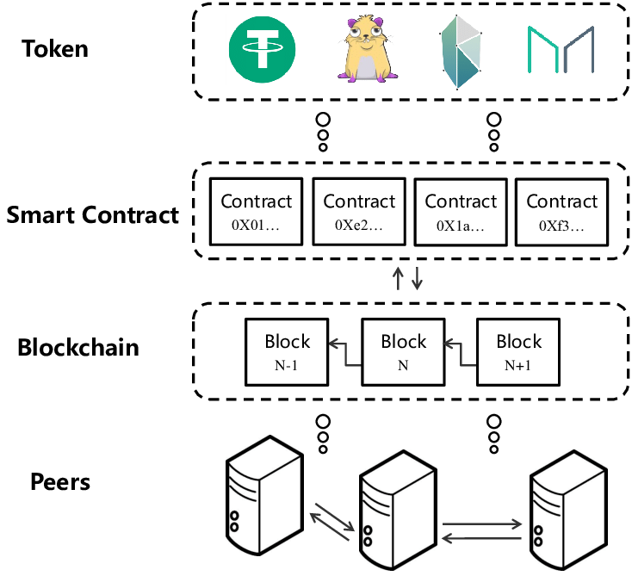

Slide 13
Need for Ethereum
Bitcoin offers only cryptocurrency exchanges.
To build decentralized applications either the traditional bitcoin block chain needs to be upgraded.
Building upon Bitcoin blockchain means living within the intentional constraints of the network and trying to find workarounds.
The limited set of datatypes, transaction types and size of data storage seems to limit the sort of application that could run on Bitcoin.

Slide 14
How does Ethereum work?
Ethereum is powered by the Ethereum Virtual Machine which allows smart contracts to run on a decentralized blockchain. These contracts self-execute only when certain conditions are met.
Smart contracts, like regular paper contracts, establish the terms of an arrangement between parties.
But unlike an old-fashioned contract, smart contracts automatically execute when the terms are met without the need for either participating party to know who is on the other side of the deal — and without the need for any kind of intermediary.
Ethereum Virtual Machine (EVM) is a computation engine which acts like a decentralized computer that has millions of executable projects.
It is considered to be the part of the Ethereum that runs execution and smart contract deployment.

Slide 15
DApp
A decentralized application (DApp, dApp) is an application that can operate autonomously, typically through the use of smart contracts, that runs on a decentralized computing, blockchain system.
Smart contracts are used by developers to maintain data on the block chain and to execute operations. Multiple smart contracts can be developed for a single DApp to handle more complex operations.
Consensus mechanisms are used by DApps to establish consensus on the network. The two most common mechanisms to establish consensus are proof-of-work (POW) and proof-of-stake (POS).

Slide 16
Features
The Ethereum block chain offers several notable features that distinguish it from other block chain platforms. Here are some key features of the Ethereum block chain:
Smart Contracts: Ethereum introduced the concept of smart contracts, which are self-executing contracts with the terms of the agreement directly written into code. Smart contracts enable the automation and execution of agreements, providing transparency, immutability, and eliminating the need for various applications.
Decentralized Applications (dApps): Ethereum serves as a platform for building decentralized applications. Developers can create dApps that leverage the Ethereum block chain's decentralized nature, security, and smart contract functionality. These applications can offer a wide range of functionalities, including decentralized finance (DeFi), gaming, NFT marketplaces, and more.

Slide 17
Tokenization: Ethereum facilitates the creation and management of tokens through its smart contract functionality. Developers can create their own tokens.
Consensus Mechanism: Ethereum is transitioning from the Proof of Work (PoW) consensus mechanism to Proof of Stake (PoS). PoW relies on computational work to validate transactions and create new blocks, while PoS relies on validators who hold and "stake" Ether as collateral. PoS aims to improve scalability, energy efficiency, and network security.
Ethereum Virtual Machine (EVM): The Ethereum Virtual Machine is a runtime environment that executes smart contracts on the Ethereum block chain.

Slide 18
Difference Between Bit coin block chain and ethereum Block chain
Basis | Bit coin | Ethereum
Definition | Bitcoin is a decentralized digital currency that can be transferred on the peer-to-peer bitcoin network. | Ethereum is a decentralized global software platform powered by block chain technology. It is most commonly known for its native cryptocurrency, ether (ETH).
Popularity | Bitcoin is the most popular digital currency in the market to date. | Ether, native currency of Ethereum is the second-largest cryptocurrency after bitcoin to date.
Consensus Mechanism | The Proof-of-Work (PoW) is the consensus mechanism used by the Bitcoin network. | The Proof-of-Stake is the consensus mechanism used by Ethereum.
Block Time | The block time of bitcoin is 10 minutes. | The block time of Ethereum is 14 to 15 seconds.

Slide 19

Ethereum is an open source, distributed software platform based on block chain technology . It has its own native cryptocurrency called Ether and a programming language called Solidity. Blockchain is a distributed ledger technology that keeps a permanent, tamper-proof list of records. Ethereum is Bitcoin's main competitor.
Ethereum enables developers to build decentralized applications. Miners produce Ether tokens that can be used as a currency and to pay for usage fees on the Ethereum network. The platform also supports smart contracts, which are a type of digital contract.

Slide 20
Thankyou

